Slide 1

ALT-SCHOOL AFRICA DATA ENGINEERING PROJECT
Presented by: Emmanuel Awa

Slide 2

Content
Project Overview
Architecture
Challenges
Issues
Resolution
Insight

Slide 3
Project Overview
Project Steps
Data ingestion into Postgres Database
Setting up Apache Airflow using Astro
Orchestrate the loading of data from Postgres DB to Bigquery
Set up DBT to transform and model the data within Bigquery
In this project, I have been tasked to develop an end-to-end ETL process using the dataset from Kaggle. The tools to be used are Postgres Database, Airflow, DBT and Google Bigquery.

Slide 4

Project Architecture
And
Challenges

Slide 5












Project Architecture
Orchestrate data flow
Kaggle dataset
Apache Airflow
DBT (Data Build Tool)
Docker container
Volumes
Data folder/
*.csv
raw data
Staging
Infra_setup/init.sql
Docker compose up
extract
load
transformed
Pg_data
With GCP
(Google cloud storage)
Google Bigquery
Postgres DB
Power BI

Slide 6

Project Challenges
Issues
Resolution
Docker compose file
I eventually got my hands on the production docker-compose file which I modified to suit local development. E.g. changing celery to loclaExecutor, removing the flower and Redis service, etc.
Various errors encountered with multiple docker-compose files leading to unhealthy services during startup.
Apache Airflow
With the new docker-compose file, I was able to start up airflow. However, after creating my DAGs, each run was successful without performing any task like moving data from postgres DB to GCS.
Airflow with Astro came to my recue. The setup was quite straightforward, and everything worked as expected.
DBT/Bigquery
In my DBT initialization, I had used the EU region, however my dataset lives in Europe west1. This caused my dbt runs to fail as it could not locate the specified datasets in EU.
I simply changed the region from EU to europe west1 in the profiles.yml file.

Slide 7

INSIGHTS

Slide 8
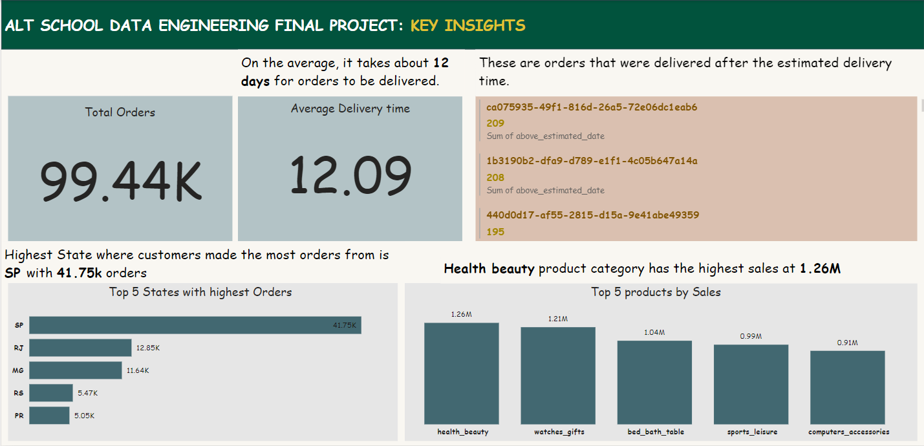
Key Insights

Slide 9

Thank you

